Slide 1

Modern Control Theory
Lecture No. 9
Sampling, Z-domain, Mapping of S-plane to Z-plane
Concept of Stability

Slide 2



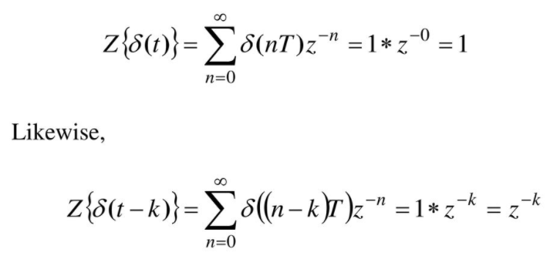



Concept of Z-Transforms

Slide 3
Understanding the Z-transforms
Taking Z-Transforms of Functions
Shifting Theorem
Initial Value & Final Value Theorems
Properties of Z-Transforms

Slide 4
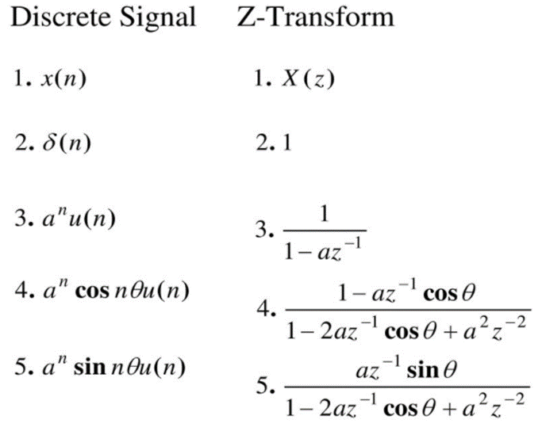
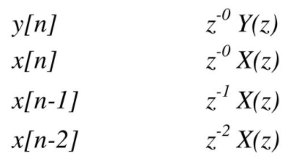
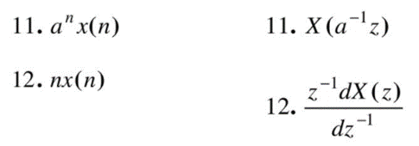
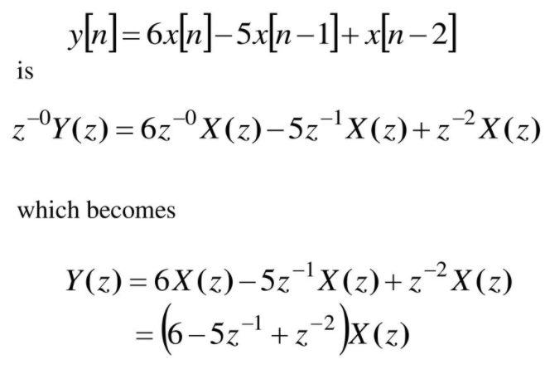
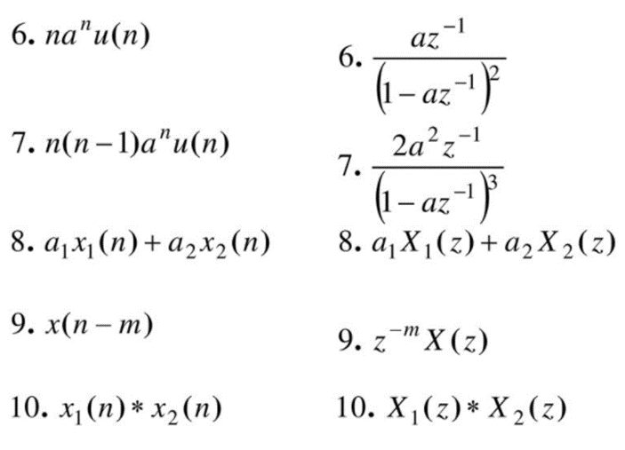
Forming Difference Equations

Slide 5
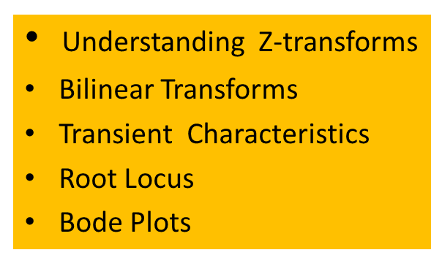

Slide 6

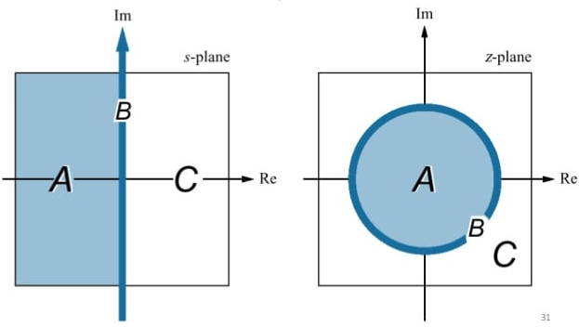
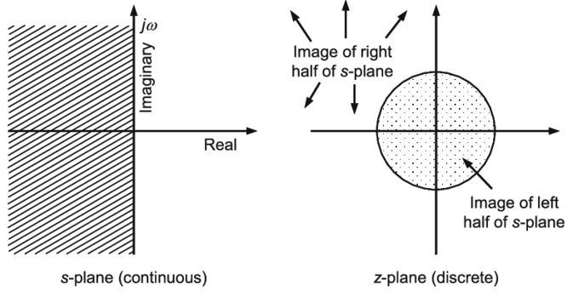

Slide 7
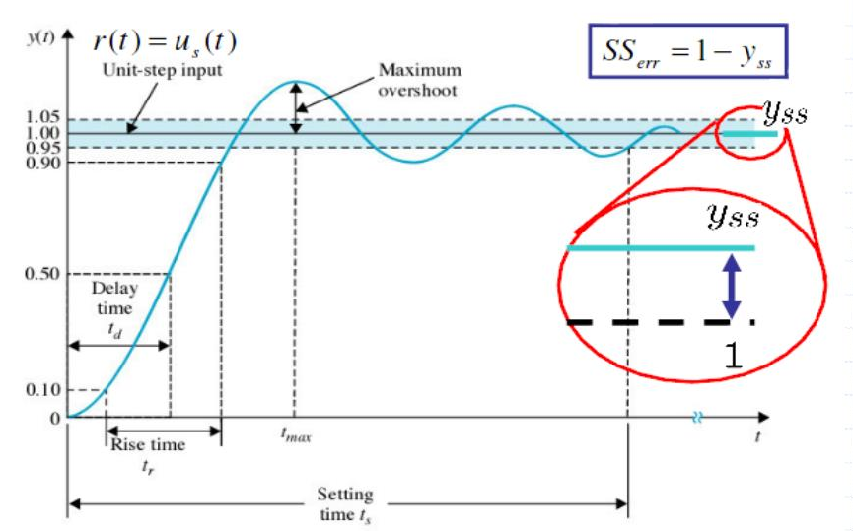
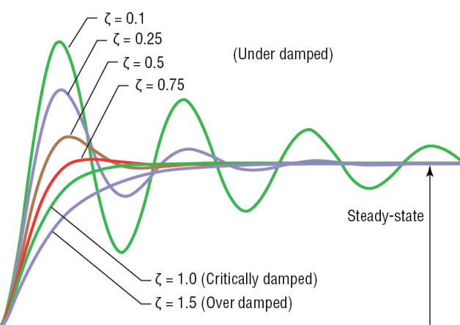
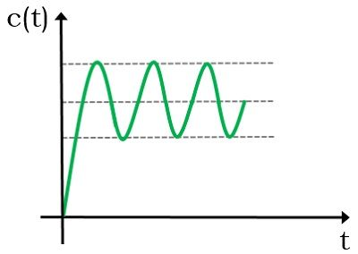
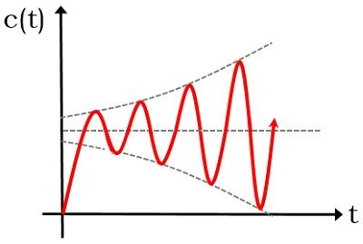
Stability in the Classical Control Concept

Slide 8







Stability Concepts
Marginal Stability
Absolute Stability
Asymptotic Stability
Lyapunov Stability
BIBO Stability
States are Bounded for most of the Inputs
There exists at-least one input, for which states are unbounded

Slide 9
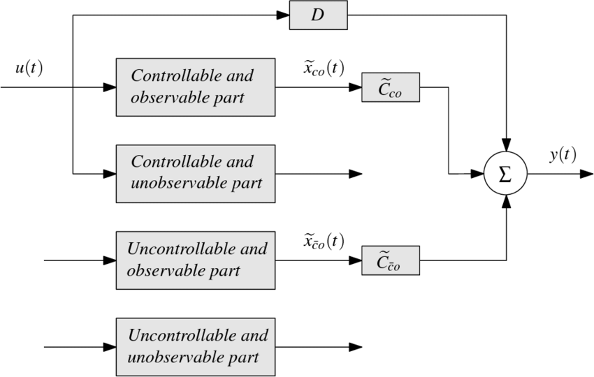
Uncontrollable & Unobservable Systems

